Slide 1
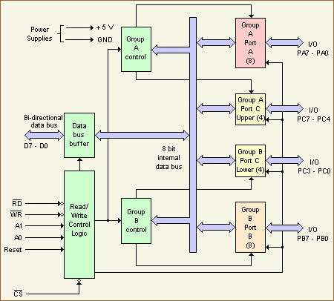
BLOCK DIAGRAM OF 8255

Slide 2
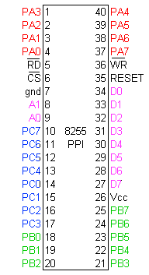

Slide 3
CONTD. BLOCK DIAGRAM OF 8255
The 8255 has 24 input/output pins in all.
Divided into three 8-bit ports.
Port A 8-bit input/output ports.
Port B 8-bit input/output ports.
Port C can be used as an 8-bit input/output port

Slide 4
Features of 8255
It is programmable, parallel I/O device.
It contains 24 programmable I/O pins.
Fully compatible with Intel microprocessor families.
Direct bit set/reset capability is available for port c.
Improve DC driving capability.
It can operate in 3 modes:
Mode 0 – simple I/O
Mode 1 – strobed I/O
Mode 2 – strobed bidirectional I/O

Slide 5
8253(PROGRAMMABLE INTERVAL TIMER)
It generates accurate time delays and can be used for real time clock, an event generator. a digital shot, a square wave generator and a complex waveform generator.
Three 16 bit counters that operate independently in any six modes.
24 pin DIP
+5V power supply
To operate a counter, a 16 bit count is to be loaded in the register on command, begins to decrement until it reaches to zero. At the end of count, it generates a pulse that can
be used to interrupt the MPU.
Counter count either in binary or BCD. Counter can also read when it is decrementing.

Slide 6
8253 PROGRAMMABLE INTERVAL COUNTER
There are 3 counter in this.
The input frequency can be divided from 1,2,-----,65536.
Input clk frequency is 0 to 2 MHz.
Shape of the output frequency:
1.square wave
2. 1-shot
3.square wave with various duty cycles

Slide 7
Contd... 8253 PROGRAMMABLE INTERVAL COUNTER
Gate is used to enable or disable the counter.
Bidirectional data bus D0-D7 is connected to the D0-D7 of the system bus.

Slide 8
PIN DIAGRAM OF 8253
D7
VCC
D6
WR
D5
RD
D4
CS
D3
A1
8253
D2
A0
D1
CLK 2
OUT 2
D0
CLK 0
GATE 2
OUT 0
CLK 1
GATE 0
OUT 1
GND
GATE 2

Slide 9
ARCHITECTURE OF 8253
DATA
BUS
BUFFER
COUNTER
0
CLK 0
GATE 0
D7-D0
OUT 0
RD
WR
A0
A1
READ/
WRITE
LOGIC
CLK 1
COUNTER
1
GATE 1
OUT 1
CS
CONTROL
WORD REGISTER
CLK 2
COUNTER
2
GATE 2
OUT 2

Slide 10
CONTROL WORD REGISTER (CWR)
SC1 | SC0 | RL1 | RL0 | M3 | M1 | M0 | BCD
D7 D6 D5 D4 D3 D2 D1 D0
D0 bit
0 Binary counter
1 BCD counter

Slide 11
D1-D2-D3 bit
M2 | M1 | M0 | MODE
0 | 0 | 0 | MODE 0
0 | 0 | 1 | MODE 1
X | 1 | 0 | MODE 2
X | 1 | 1 | MODE 3
1 | 0 | 0 | MODE 4
1 | 0 | 1 | MODE5

Slide 12
D4-D5 bit
RL1 | RL0 | FUNCTION
0 | 0 | Counter latching
0 | 1 | Read/ write LSB
1 | 0 | Read/write MSB
1 | 1 | Read/write LSB then MSB

Slide 13
D6-D7 bit
D6 | D7 | COUNTER
0 | 0 | COUNTER 0
0 | 1 | COUNTER 1
1 | 0 | COUNTER 2
1 | 1 | ILLEGAL

Slide 14
MODES OF 8253
MODE 0: Interrupt on terminal count.
MODE 1: Programmable 1 shot.
MODE 2: Rate generator.
MODE 3: Square wave generator.
MODE 4: Software triggered strobe.
MODE 5: Hardware triggered strobe.

Slide 15
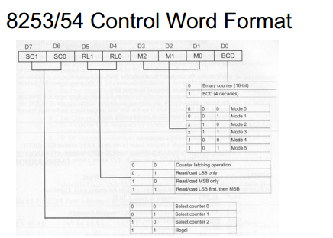

Slide 16
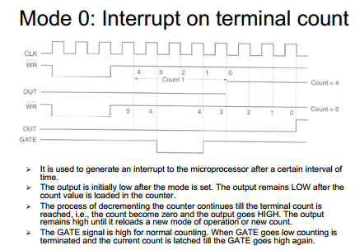

Slide 17
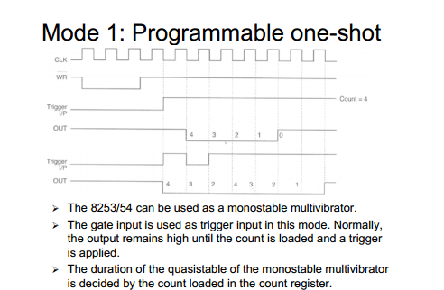

Slide 18
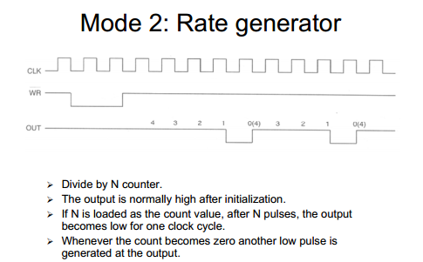

Slide 19
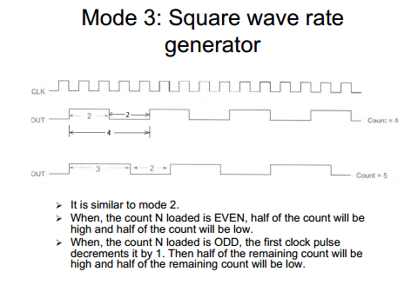

Slide 20
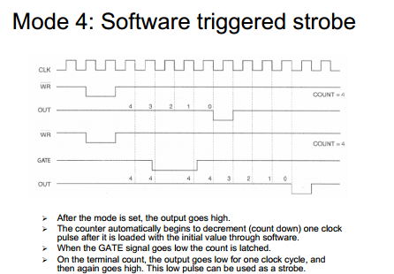

Slide 21
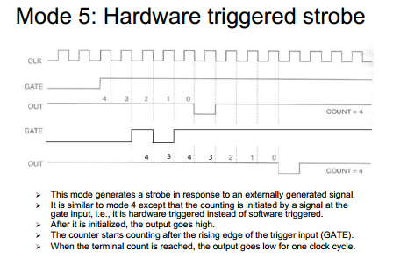

Slide 22
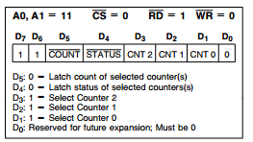

Slide 23
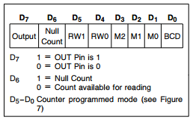

Slide 24
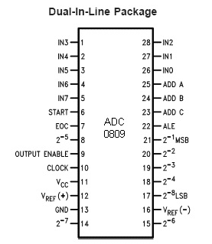

Slide 25
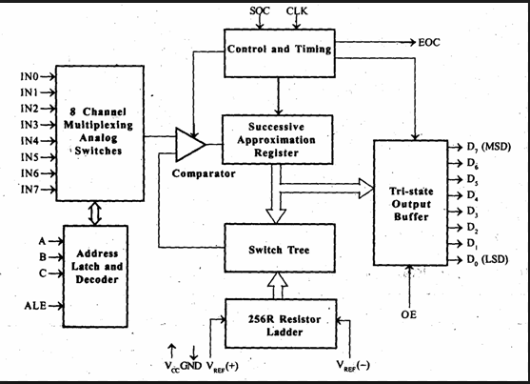

Slide 26
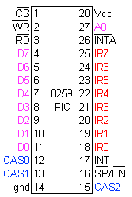
The pin configuration of 8259

Slide 27
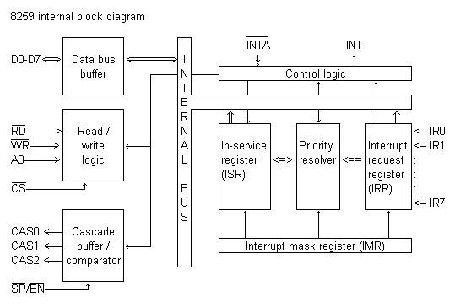
Architecture of 8259

